Slide 1

NETW211 Project
Teyvone Wells
2/16/2023

Slide 2



Virtual Machine (VM) Instances

Slide 3
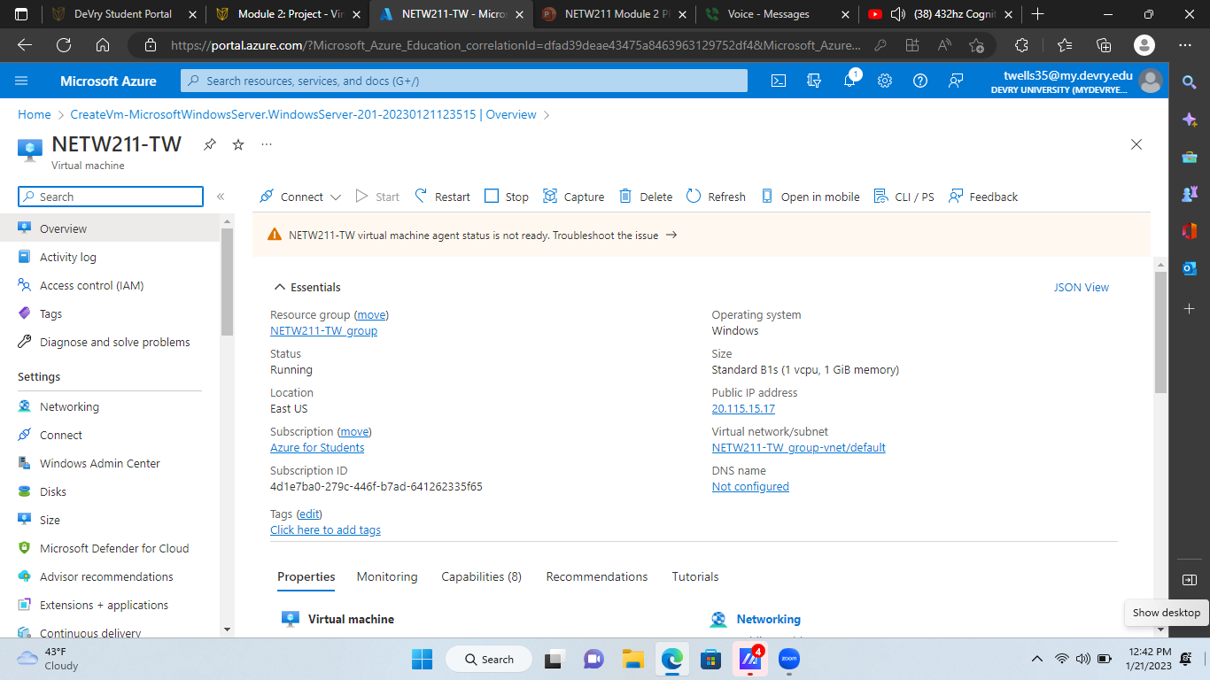
The first of my objectives in completing my project entailed using Microsoft Azure to develop and configure a Virtual Machine (VM) instance.
Deploying a VM in Azure

Slide 4
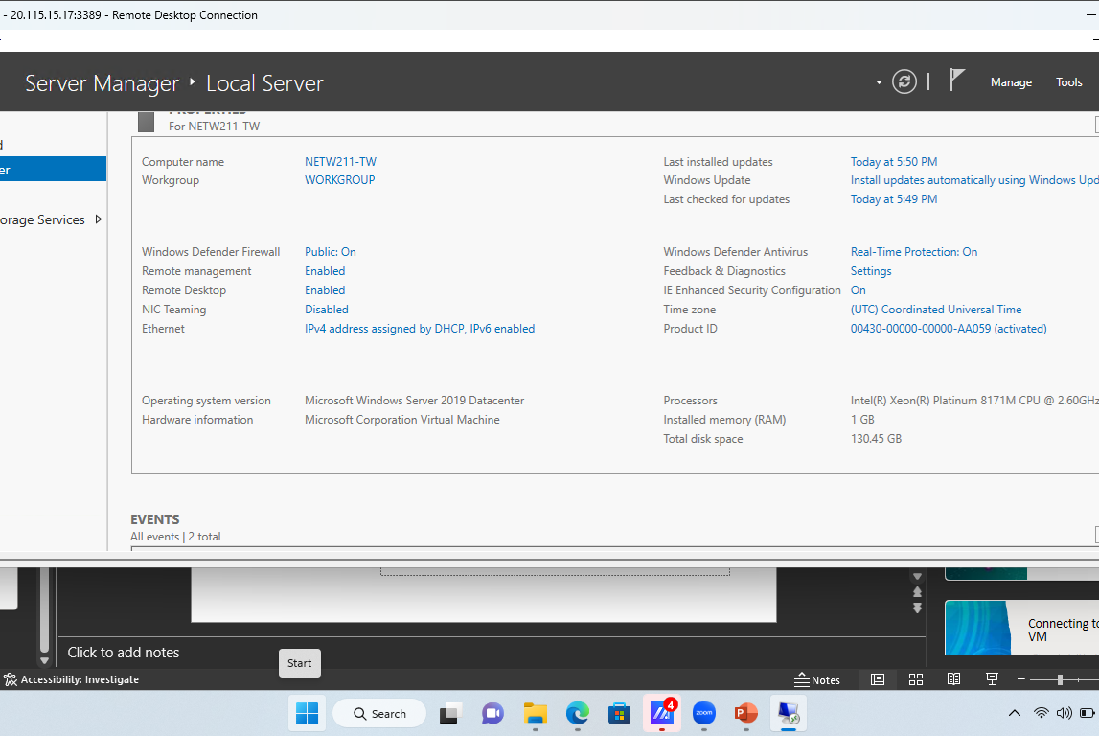
Connecting to the VM
Here is a photo of the running VM’s connection configurations in it’s Server Manager window.

Slide 5
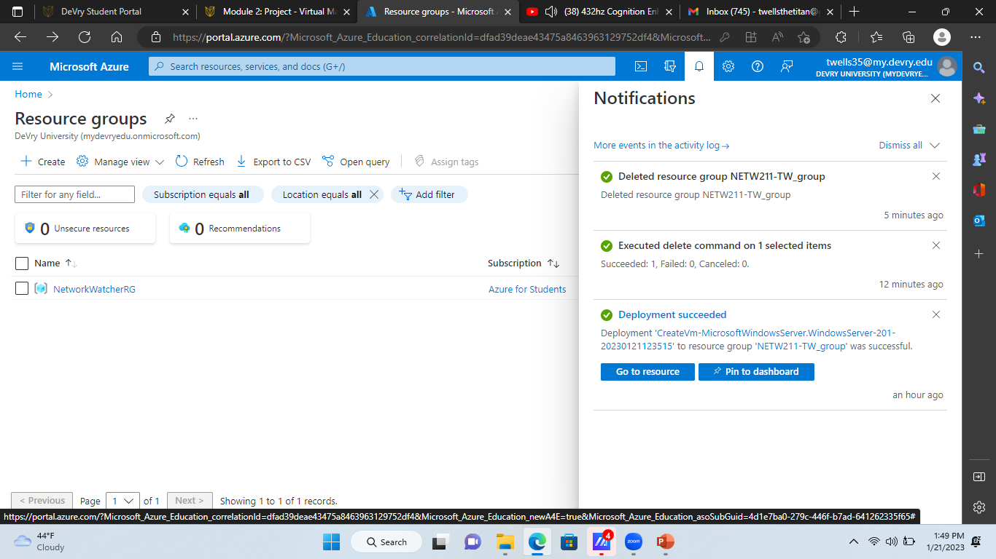
Here is a screenshot of the “Resource Groups” page on Azure. I had the notifications tab open to show that I had deleted the VM instances I created previously, as well as it’s Resource group (Which is shown empty).
Deleting the VM

Slide 6

Azure VNet & Subnets
2

Slide 7
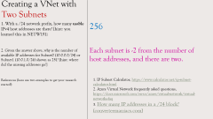
Creating a VNet with Two Subnets
1. With a /24 network prefix, how many usable IPv4 host addresses are there? [hint: you learned this in NETW191]
2. Given the answer above, why is the number of available IP addresses for Subnet0 (10.0.0.0/24) or Subnet1 (10.0.1.0/24) shown as 251? [hint: where did the missing addresses go?]
References (here are two examples to get your research started):
256
Each subnet is -2 from the number of host addresses, and there are two.
1. IP Subnet Calculator, https://www.calculator.net/ip-subnet-calculator.html
2. Azure Virtual Network frequently asked questions, https://docs.microsoft.com/en-us/azure/virtual-network/virtual-networks-faq
3. How many IP addresses in a /24 block? (convertermaniacs.com)

Slide 8
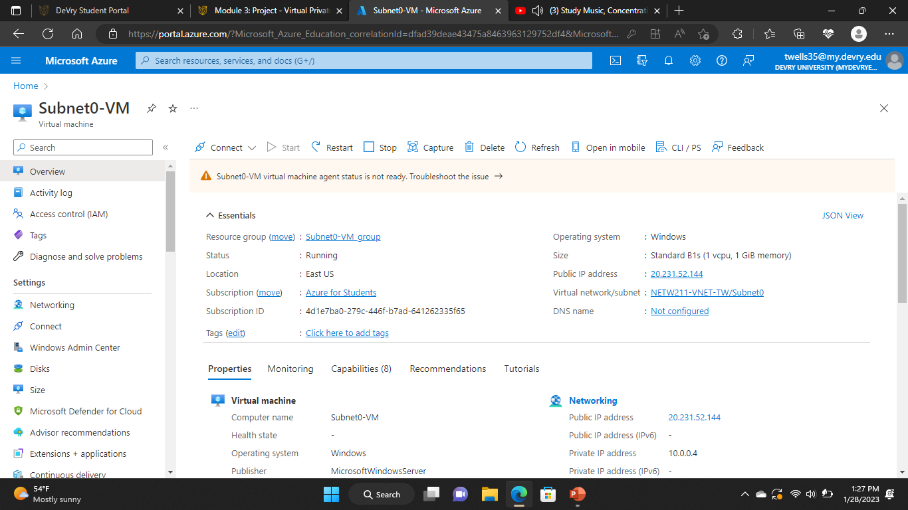
Deploying VMs into Subnets
Here is a screenshot of my first subnet VM (Subnet0). It is the first of 2 Subnets that will be connected to my host VM, wielding the Private IP address “10.0.0.4”

Slide 9

Deploying VMs into Subnets cont’d
Here is a screenshot of my second subnet (Subnet1). Its the last of the 2 Subnet VMs that will be connected to my host VM, wielding the Private IP address “10.0.1.4”.

Slide 10
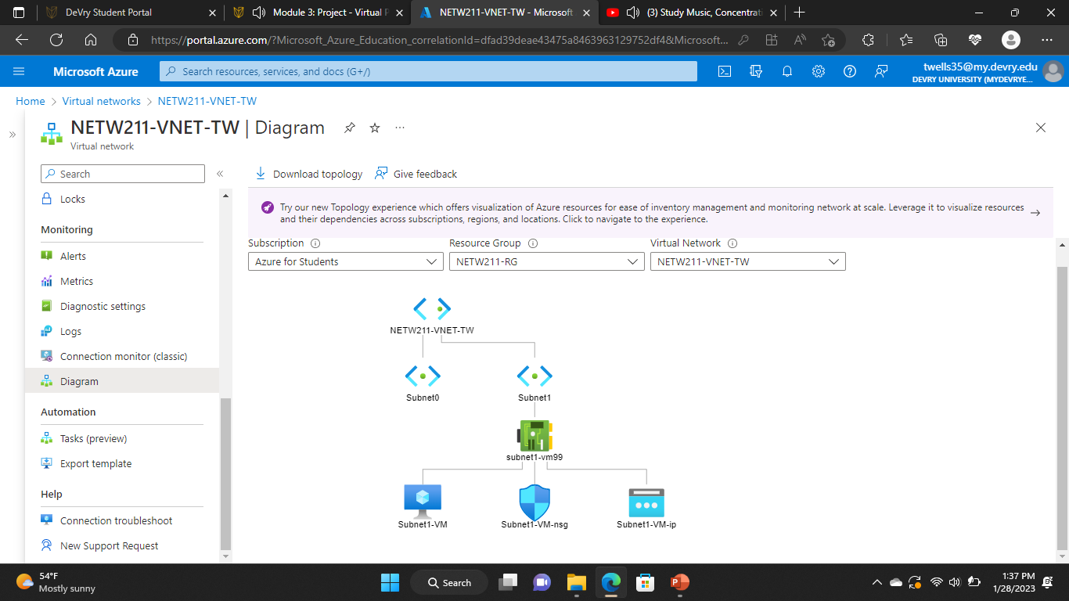
Deploying VMs into Subnets cont’d
This screenshot should show the topology diagram of my VNet with its two subnets (Subnet0 and Subnet1) and one VM in subnet1. (VM in subnet0 was said to be active, but wouldn’t appear)

Slide 11
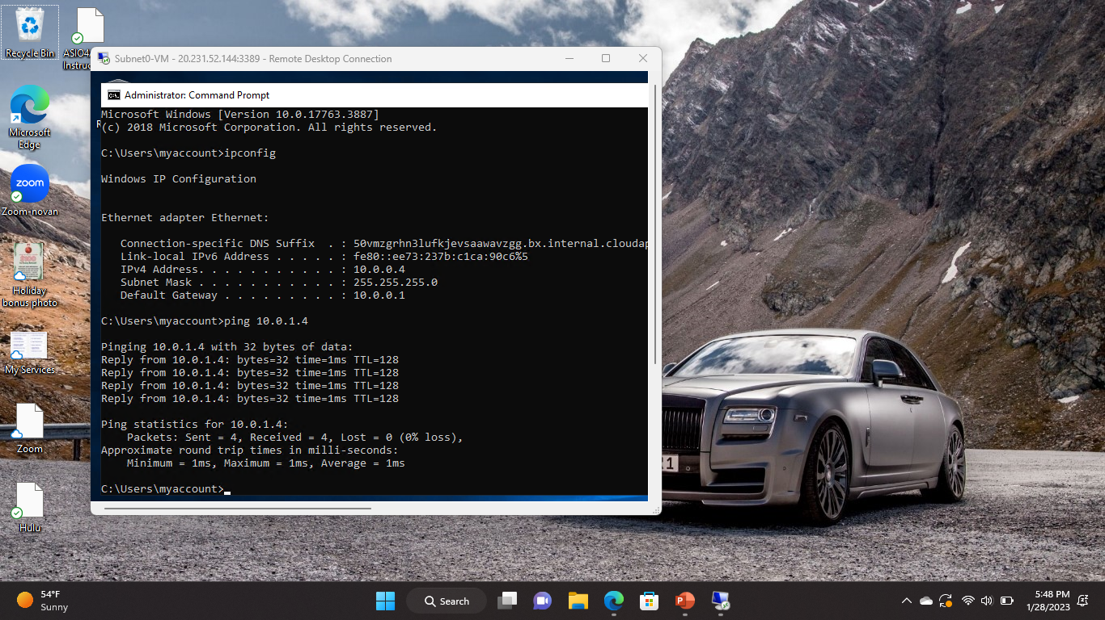
Verifying Connectivity between VMs
This screenshot shows the ipconfig and ping 10.0.1.4 (Subnet1) results in the command prompt window of subnet0 VM

Slide 12
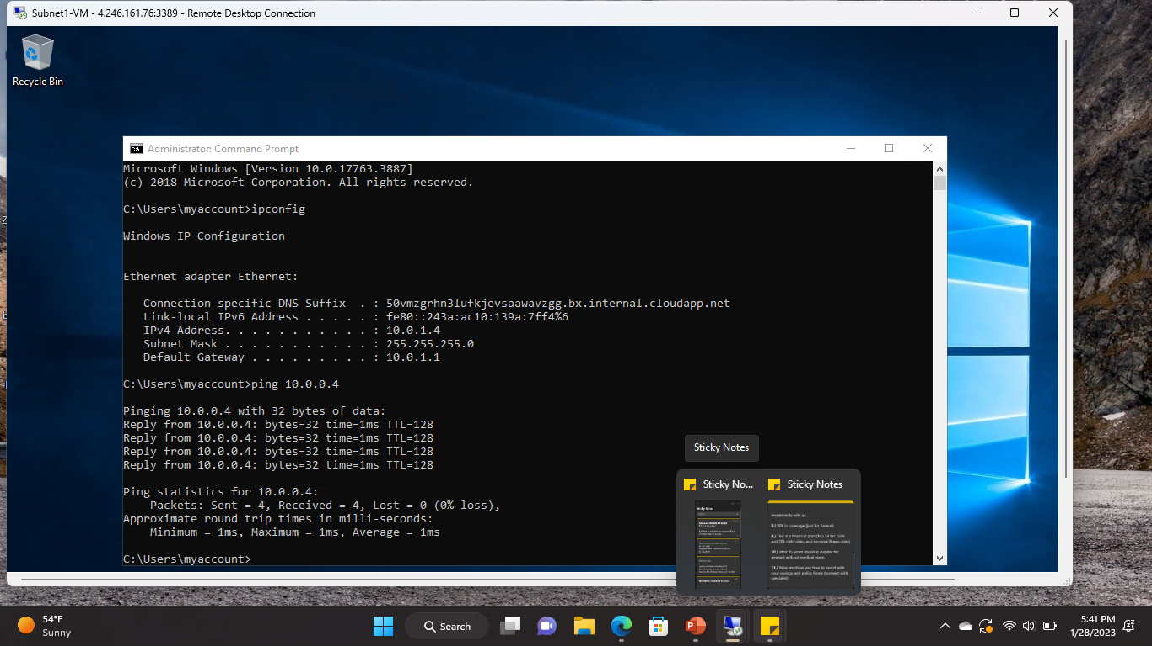
Verifying Connectivity between VMs
cont’d
This screenshot shows the ipconfig and ping 10.0.0.4 (Subnet0) results in the command prompt window of subnet1 VM

Slide 13

Azure VM Security
3

Slide 14
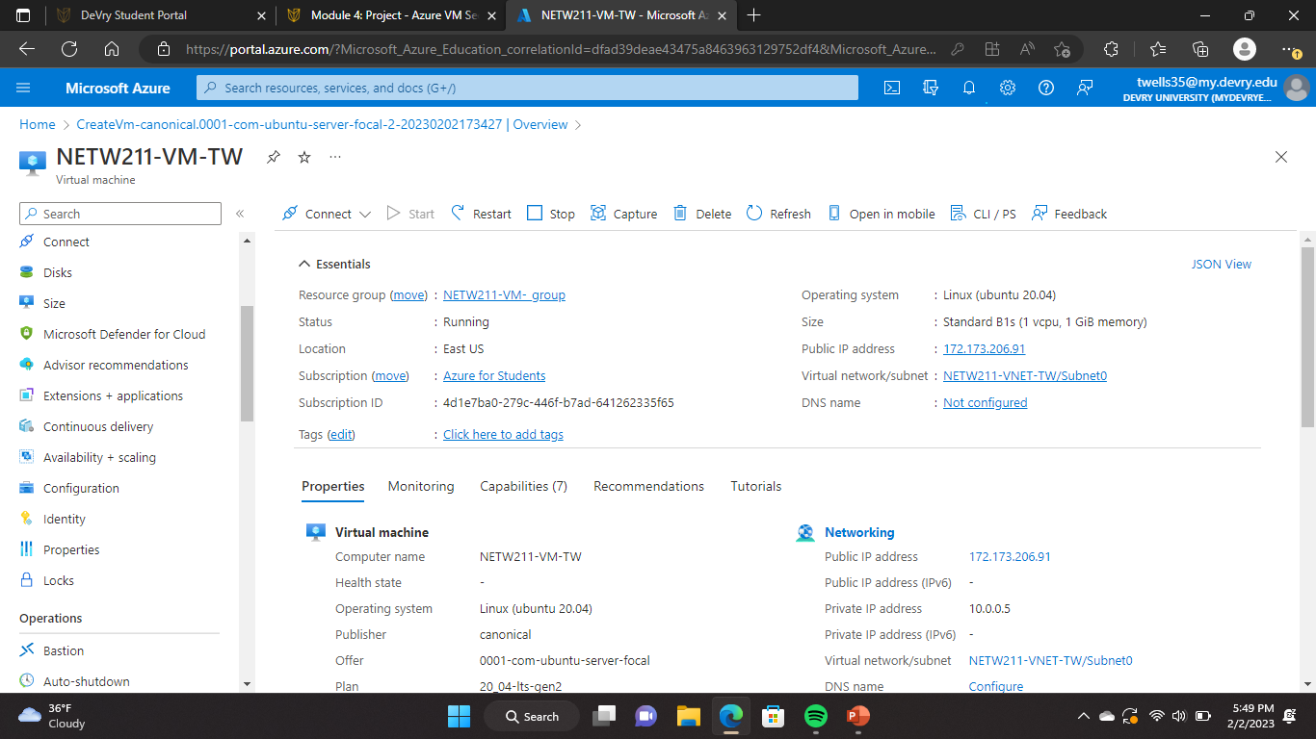
Launching a VM
Here is a screenshot of the resource group name, subscription, public IP address, etc, for my host VM.

Slide 15
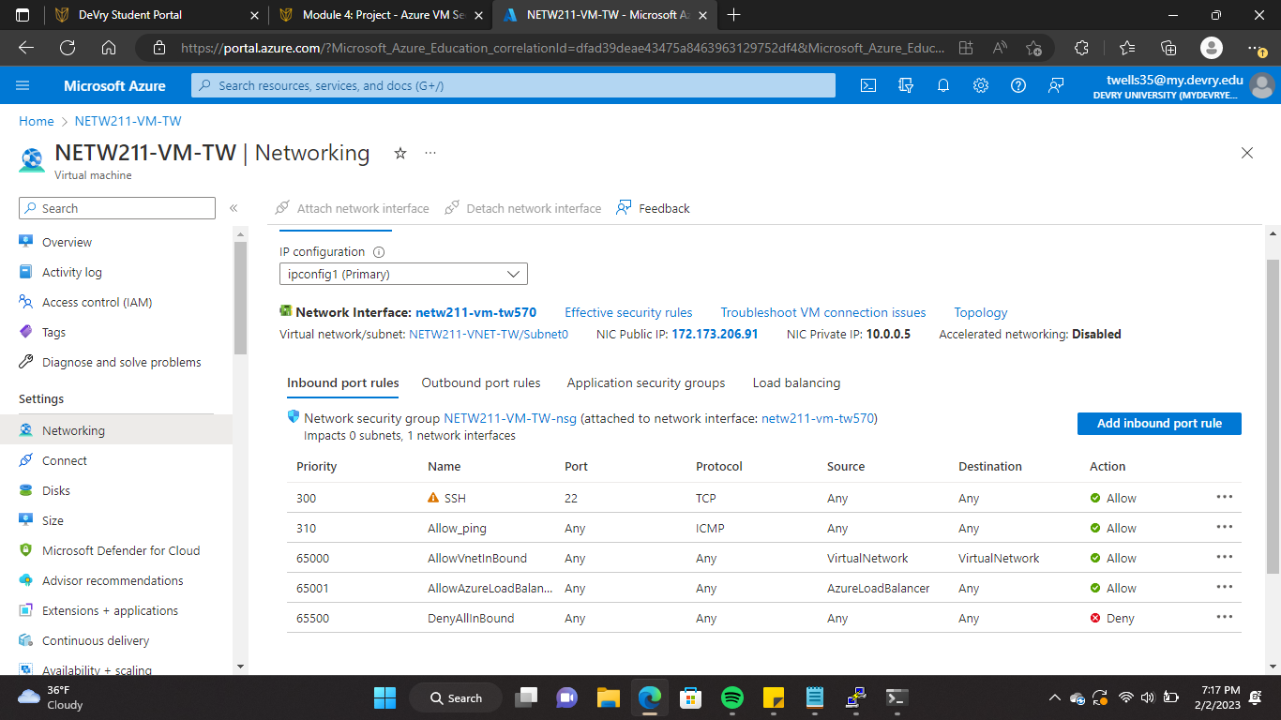
Here is a screenshot showing my configuration of my VM’s Allow/Deny Rules. I had to enable the VM to be able to receive pings between it’s subnets and itself.
Configuring an NSG

Slide 16
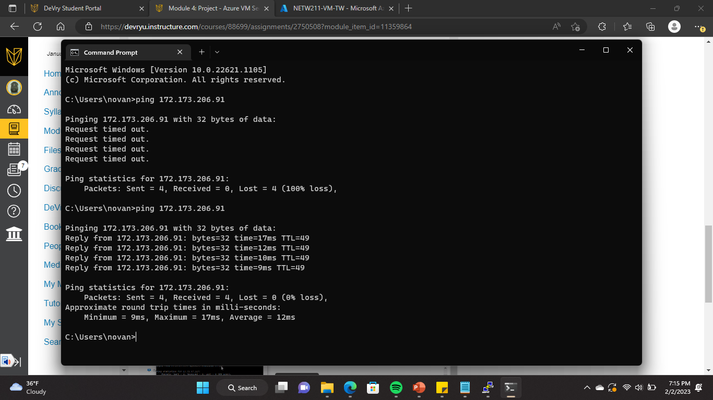
This screenshot displays the successful ping result from my personal computer to the VM in the Azure cloud.
Configuring an NSG
cont’d

Slide 17

Cloud Storage
4

Slide 18
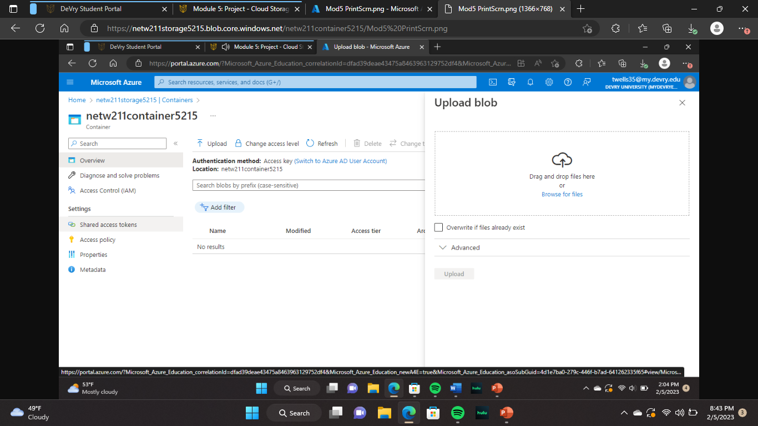
Uploading and Accessing a File
The next of portion of my project prompted me to learn to create files in various formats and uploading them in Cloud network storage.

Slide 19
Question
What does the access tier setting do? What are the Azure blob storage access tiers?
The various Access tiers include:
References (here are two examples to get your research started):
The Access Tier setting optimizes storage costs by placing data in appropriate access tier.
Hot, Cool, and Archive.
1. Hot, Cool, and Archive access tiers for blob data, https://docs.microsoft.com/en-us/azure/storage/blobs/access-tiers-overview
2. Azure Blob Storage Access Tiers, https://devry.percipio.com/courses/c7ef0333-8560-403f-a004-9c5c843866b0/videos/2658bbe6-ee97-438b-a376-fbb079c3b3a0

Slide 20
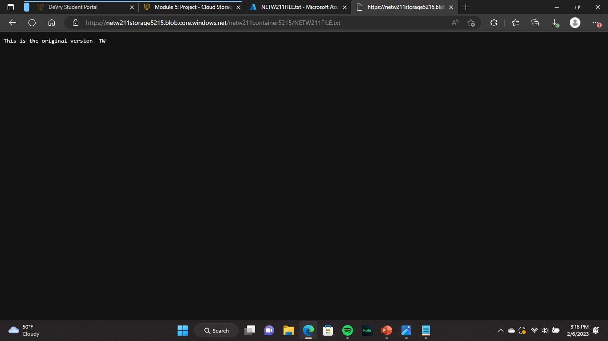
Creating Blob Snapshots
This screenshot displays my browser window with the “This is the original version. –Your Initials” message and the URL on top of the window. This is the original version of the file that I uploaded and edited in the cloud.

Slide 21

Enabling Blob Versioning
This screenshot shows the browser window with the “This is the first revised version. -TW” message and the URL on top of the window. This is one of multiple revised versions that I created by taking snapshots before and after edits have been made to generate the new version.

Slide 22

Cloud Monitoring
5

Slide 23
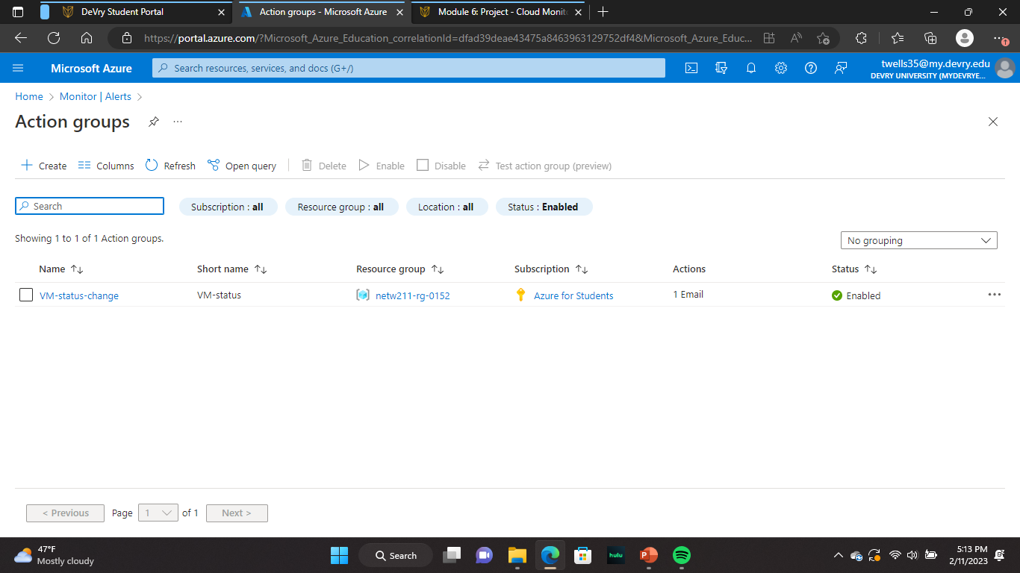
Setting up an Action Group and Notification
The first step in this portion of the project was to create the “VM-Status-Change” action group. Here is that action group listed on the Manage actions page.

Slide 24
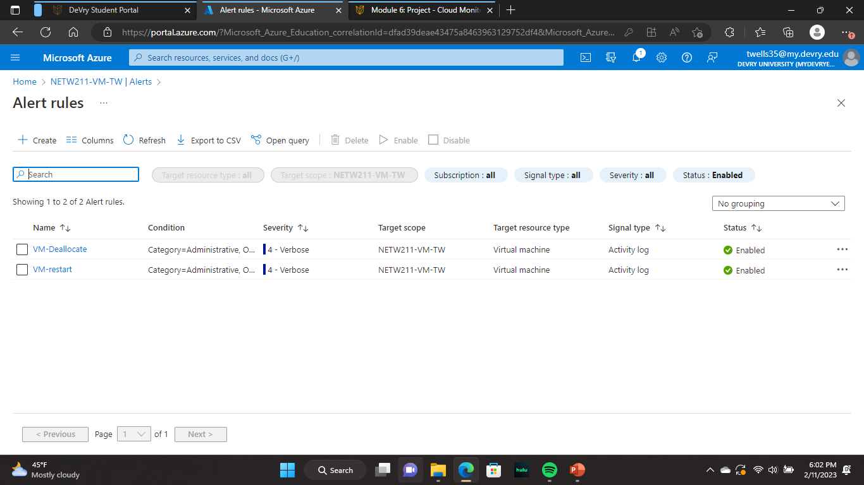
Setting up Alert Rules
Within the previously generated Action group, it was time to apply some “Alert Rules” to configure what to notify the admin about. (Status updates). As you can see, I generated two alert rules to log and notify me of both restarts (VM-restart) and Deallocations (VM-Deallocation)

Slide 25
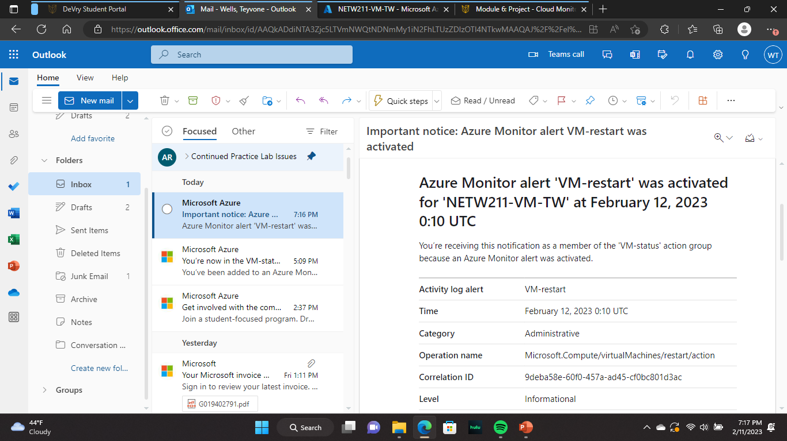
Testing
Alerts
Here is a screenshot of the first test of the VM-Restart alert rule. I restarted the VM and received an email notification of the restart to the email I applied to the configuration of the alert rule.

Slide 26
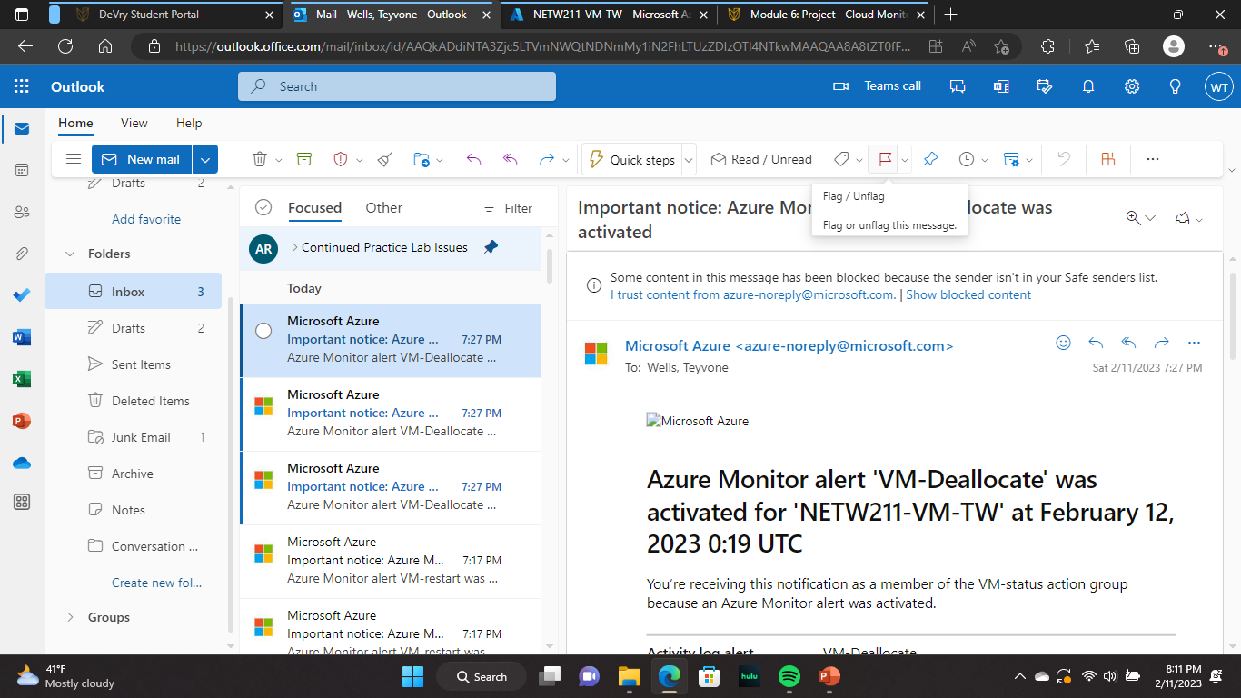
Testing Alerts cont’d
Here is a screenshot of the first test of the “VM-Deallocate” alert rule. I restarted the VM and received an email notification of the deallocation to the email I applied to the configuration of the alert rule.

Slide 27

Challenges
I so very much enjoyed completing this project so it was difficult to find a challenge (Finding a pattern here). Although, One challenge I have had through the entire duration of completing this project was containing my excitement to complete it each week. On a serious note, I made a small mistake at a certain point in the project that made completing it a little more of a task than anticipated. There was a point in the project where while following my instructions I became distracted and didn’t follow the proper guidelines as far as deletion. I had to backtrack and reassess where it was I went wrong which essentially was not deleting the VM’s and resource group I had generated previously. This led to me reaching the storage limit of my Devry student account on Azure. Luckily I received notification of this event in trying to generate more resource groups and VMs and knew to backtrack to my logs and delete old components.

Slide 28

Career Skills ObtainED (AZURE)
Generating Virtual Machine (VM) Instances
Building a VNET containing a host VM and Subnets
Generating and configuring Network security groups (NSG) for the VNET
Generating and maintaining Cloud Storage (Uploading, Editing, Arranging files)
Generating and assigning alerts to various actions, changes, and states for efficient administrator notification and monitoring

Slide 29



Conclusion
As I have stated before, I thoroughly enjoyed completing this project just as I have every other I have completed. I am thankful for each person who will review and be able to utilize this information and my experiences in the future. I also deeply appreciate my professors and fellow classmates who have been a support to me and my education whether they know the impact or not. Thanks again to all of you!

Slide 30
References
1. Hot, Cool, and Archive access tiers for blob data, https://docs.microsoft.com/en-us/azure/storage/blobs/access-tiers-overview
2. Azure Blob Storage Access Tiers, https://devry.percipio.com/courses/c7ef0333-8560-403f-a004-9c5c843866b0/videos/2658bbe6-ee97-438b-a376-fbb079c3b3a0
3. IP Subnet Calculator, https://www.calculator.net/ip-subnet-calculator.html
4. Azure Virtual Network frequently asked questions, https://docs.microsoft.com/en-us/azure/virtual-network/virtual-networks-faq
5. How many IP addresses in a /24 block? (convertermaniacs.com)

Slide 31
Wix Portfolio
Portfolio | Novanet Logistics

